Slide 1
Duke HR System
Team: Duke
Members:
Sakshi Jain
Sarinder Virk
Serdar Demirci
Ashika Anand Babu

Slide 2

Content
About
Technology stack
Architecture
UML Diagram
Sequence Diagram
Demo

Slide 3
ABOUT
Our application is Duke HR System.
Major Functionalities are:
Organisation flow (View of employee)
Payroll management
Timesheet management
Roles:
HR Manager
Manager
Employee

Slide 4
TECH STACK
Backend : DynamoDB
Cloud : AWS Amplify
AppSync / GraphQL
Cognito
Frontend : React.js

Slide 5
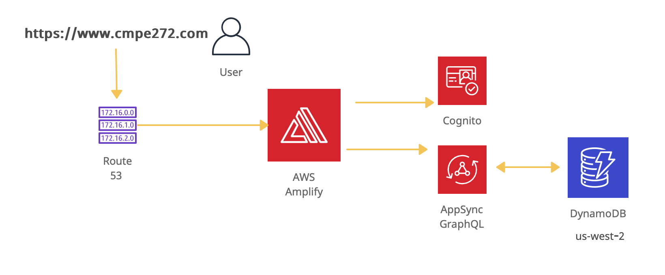
ARCHITECTURE

Slide 6
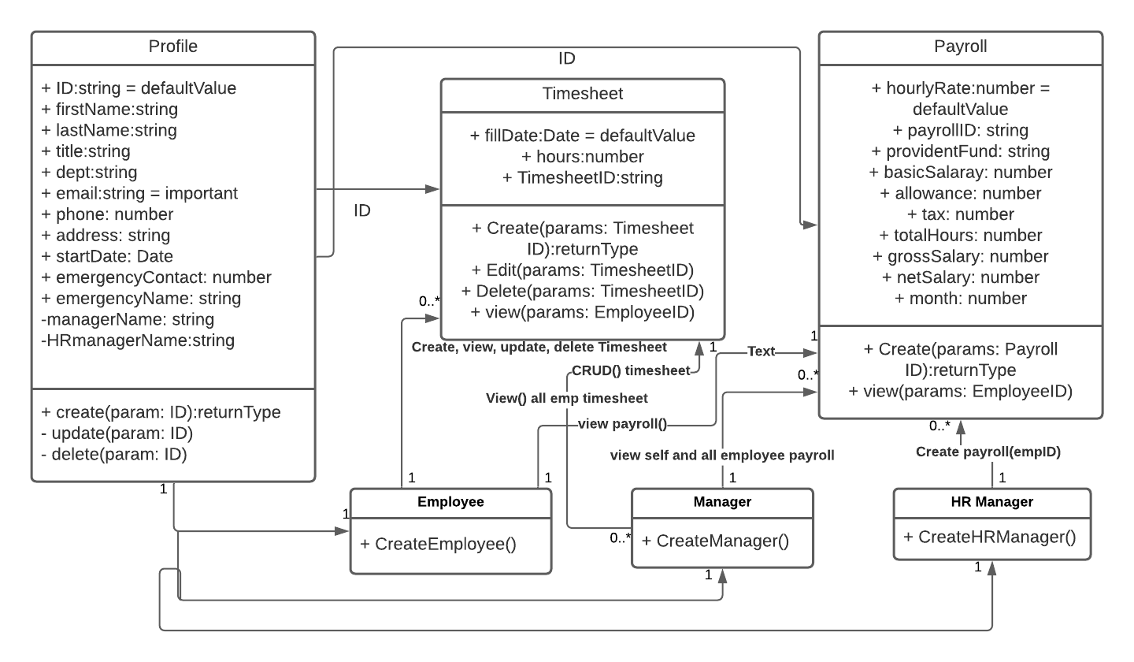
UML Diagram

Slide 7
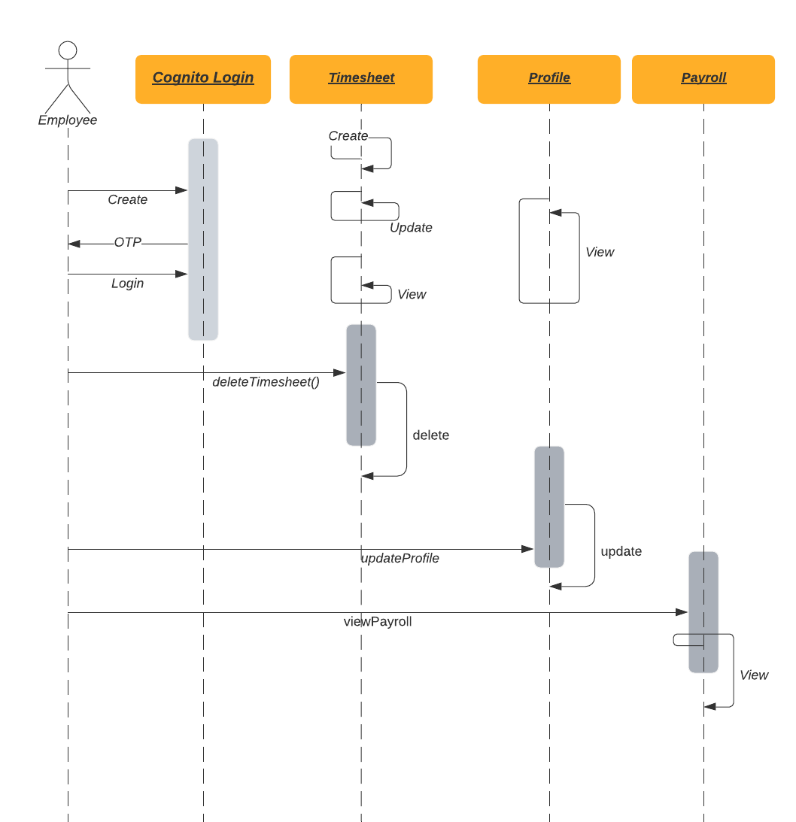

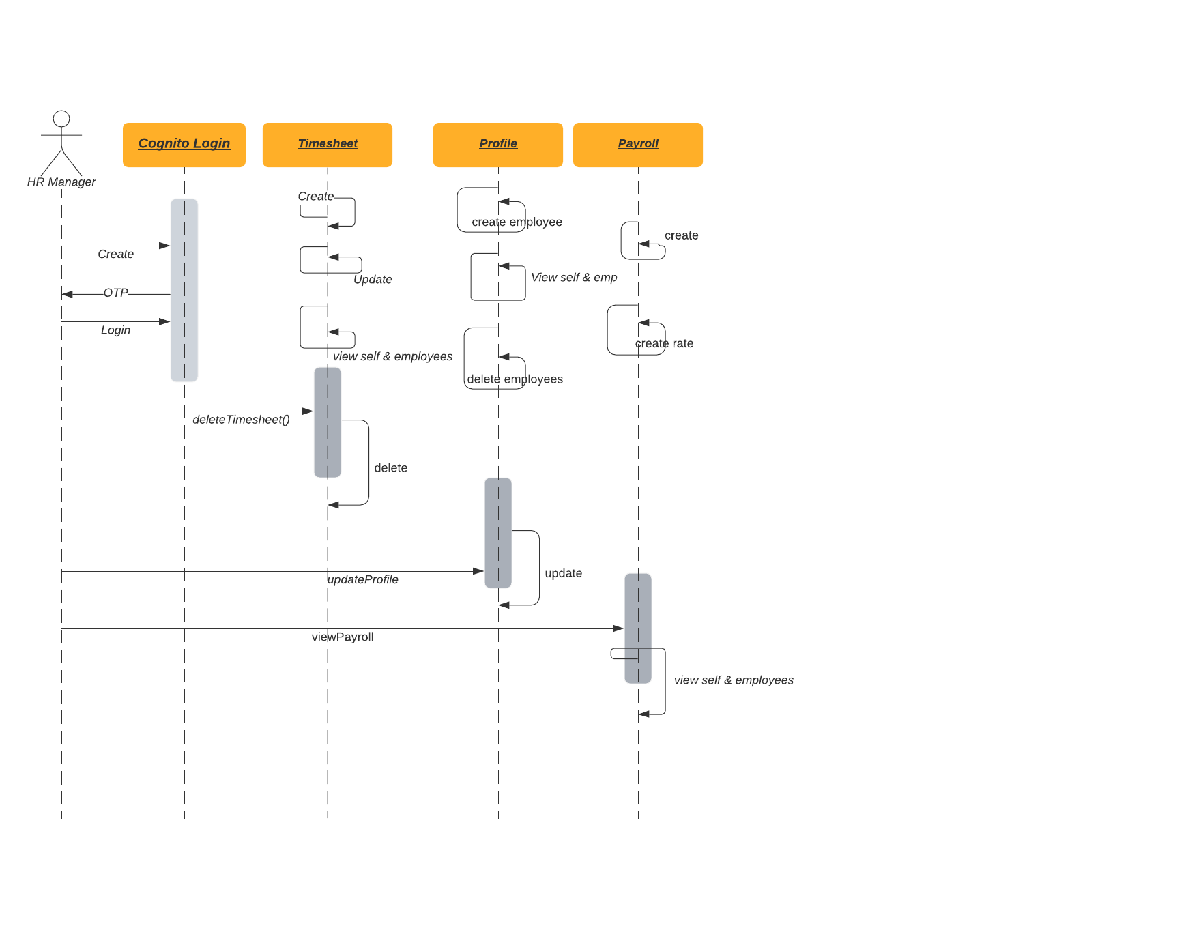
SEQUENCE DIAGRAM

Slide 8
DEMO
https://www.cmpe272.com/
Github: https://github.com/sarinderv/cmpe272duke.git

Slide 9
Thank You!
Any Questions?

